Slide 1
IN THE NAME OF GOD

Slide 2
Atropa belladonna
Dr Mahdi Alibeigi

Slide 3
An Atropa belladonna L. poisoning with acute subdural hematoma
Abstract
Atropa belladonna L. is a plant long known to cause poisoning. But no cases of acute subdural hematoma resulting from such poisoning have been reported so far.
Care must also be taken in terms of acute pancreatitis and rhabdomyolysis in cases of such poisoning.
The plant may sometimes be mistaken for the Caucasian blueberry, V. arctostaphylos L.
At least one anti-cholinesterase toxidrome finding was determined in all the nine cases of belladonna poisoning in this series.
No elevated creatine kinase was reported in one case with acute subdural hematoma and hyperamylasemia.

Slide 4
Introduction
Atropa belladonna L is a perennial bushy herb. It is found across the northern Anatolia and grows among Fagus orientalis Lipsky and Picea orientalis L. woodlands and in shady places.
The berries are black, shiny and sweet and are consumed by animals that disperse the seeds in their droppings, even though the seeds contain toxic alkaloids, notably hyoscine (also called scopolamine), hyoscyamine and atropine. The berries also contain the tropane alkaloid atropine.
The name ‘belladonna’ comes from the Italian, meaning ‘beautiful lady’, originating either from its use as a facial cosmetic, or, more probably, from its use to increase pupil size in women.
The Caucasian blueberry, V. arctostaphylos L, looks like Atropa belladonna L. It is a deciduous shrub and 1–6 m in length. The succulent fruits of all the Turkish species can be eaten, those of V. arctostaphylos being especially prized

Slide 5
Cases
Nine patients were admitted to their local hospital and our university hospital, which serves as regional toxicology centre. They had suspected poisoning caused by consuming A. belladonna L.
They had consumed A. belladonna L. by mistake instead of blueberrys during tourist excursions.
One or more anti-cholinergic toxidrome findings— agitation, dry mucosa and tongue, tachycardia, urinary retention, hallucination, hyperthermia, dilated pupils and hypertension—were present in almost all patients.
Computed tomography was performed on one patient due to loss of mental status and unilateral loss of strength. Tomography revealed acute subdural hematoma and shift in the left fronto-parietal region.

Slide 6
Cases
That patient had a temperature of 38.8C, blood pressure of 160/110 mmHg and respiration of 26/min. Pupils were dilated, with a Glasgow Coma Score (GCS) of 4 (E1M2V1) and IR /.
The patient developed globe vesicle and hypoactive bowel sounds. The patient has multiple sclerosis and takes copaxone vials, fosamax and Ca-D vit.
The patient was taken for brain surgery. Holes were opened in the left frontal and parietal region using a burr and then widened and the hemorrhage was relieved. The dura was anastomosed to the bone and the layers closed in an anatomically compatible manner with the installation of two soft drains.
The patient regained mental status on the first day postoperatively and was oriented and cooperative, IR was ‏/‏, the pupils isocoric and GCS was 15. There were 4/5 paresis previously existing in the lower left extremity as MS sequelae. Hallucinations and agitations persisted intermittently for 3 days.
The patient spent 6 days in an intensive care and 5 days on the ward, being discharged on day 11. The change in the laboratory values of this patient is shown in the Table 1.

Slide 7
Cases
The other patients improved within 3 days and they were discharged. Some of them had altered mental status, hallucination and agitation. Stomach washing and activated charcoal was administered to patients with severe symptoms. Agitated patients were sedated with benzodiazepine.
Anti-cholinesterase inhibitors, such as physostigmine, were not administered as these could not be obtained under emergency conditions.

Slide 8
Discussion
A. belladonna L. is frequently taken by adults for the purpose of suicide and to establish a hallucinogenic effect. Accidental consumption in adults is rare.
A. belladonna L. contains hyoscyamine, atropine and scopolamine. Accidental ingestion of deadly nightshade berries can induce an anti-cholinergic toxidrome. All anticholinergic toxidrome findings may be encountered in A. belladonna L. poisoning.
Clinical manifestationsare caused by central nervous system (CNS) effects, peripheral nervous system effects, or both. Common signs and symptoms include flushing, dry skin and mucous membranes, mydriasis with loss of accommodation, altered mental status and fever. Additional manifestations include sinus tachycardia, decreased bowel sounds, functional ileus, urinary retention, hypertension, tremulousness, and myoclonic jerking.
Patients with central anti-cholinergic syndrome may present with ataxia, disorientation, short-term memory loss, confusion, hallucinations (visual, auditory), psychosis, agitated delirium, seizures (rare), coma, respiratory failure or cardiovascular collapse.

Slide 9
Discussion
Treatment in anti-cholinergic poisoning is conservative.
Patients require monitoring, and severe casesrequire intensive care monitoring. The use of activated charcoal is beneficial. Benzodiazepines are a good choice for sedation in the presence of agitation.
Physostigmine may be useful in severe cases. Physostigmine reverses CNS and toxic effects of agents. Physostigmine can cause seizures and exaggerated parasympathetic responses, so atropine should be available to reverse its effects. Recommended doses in adults are 0.5–2 mg repeated every 20 min, slowly and intravenously over 1 min, or intramuscularly until response or an adverse reaction occurs. An additional 1–4 mg may be given every 30–60 min as needed to control symptoms.
Two of our cases exhibited severe anti-cholinergic symptoms. These patients were not administered physostigmine in the early period as it could not be obtained. Seven other cases were not sufficiently clinically severe to warrant physostigmine.
The reason for the acute subdural hematoma in the patient concerned is unclear. It may be that the acute tachycardia and hypertension arising in such patients prepared the way.

Slide 10
Discussion
Anti-cholinergic poisoning-related hyperamylasemia and rhabdomyolysis appear in the literature, but it is unclear whether the hyperamylasemia in our case was due to anti-cholinergic poisoning or to the anesthetic agents employed during surgery. It is also unclear whether the elevated creatine kinase in our case was due to poisoning or to anesthetic agents; however, one conclusion to be drawn from these cases is the need for care in terms of acute pancreatitis and rhabdomyolysis in cholinergic poisoning.
A. belladonna L. may sometimes be confused with the Caucasian blueberry L. and consumed in error. But no cases of acute subdural hematoma resulting from such poisoning have been reported. Care must also be taken in terms of acute pancreatitis and rhabdomyolysis in such poisoning.

Slide 11
Poisoning with Atropa Belladonna in Childhood

Slide 12
Poisoning with Atropa Belladonna in Childhood
Abstract
Background: Intoxication with Atropa belladonna is endemic in Eastern Anatolia especially in springtime. However, in literature, there are no much studies about Atropa belladonna intoxication in childhood.
Objectives: This study examines clinical and laboratory findings of pediatric Atropa belladonna intoxication cases.
Methods: Hospital official database was searched for international classification of diseases code of intoxication. The inclusion criteria included individuals under the age of 15 and who had a history of Atropa belladonna ingestion.
Results: The most frequent clinical findings were mydriasis, flushing, and meaningless speech. There was a significant rise in the white blood cell count, glucose, aspartate aminotransferase, and C - reactive protein levels.
Conclusions: Atropa belladonna intoxication clinically causes anticholinergic syndrome and can result in deteriorations in some laboratory tests.

Slide 13
Background
The clinical picture of symptoms and signs that break out if a toxic material is ingested is named as “intoxication”. Approximately 80% of intoxications are accidental. Although all age groups are candidates for intoxication, it is more common and mortal, especially for children aged.
While household chemicals, pesticides, hydrocarbons, drugs, and plants are mostly responsible for childhood intoxications all around the world; drugs (43.4%) and vegetation and/or plants (21.8%) are the most common causative agents in Turkey .
Atropa belladonna, known as “deadly nightshade” in folk terminology, is a poisonous plant that grows in nature. This plant, which belongs to Solanaceae family, contains intensely alkaloids such as atropine, scopolamine, and hyoscyamine in its leaves, roots, and fruits.
It is already recorded in the literature that active substances like atropine, which cause anticholinergic intoxication establish a clinical picture of symptoms and signs including agitation, hallucinations, mydriasis, ataxia, urinary retention, delirium, flushing, and tachycardia.
In this study, clinical and laboratory findings of 174 pediatric patients are examined.

Slide 14
Methods
This retrospective study includes 174 patients who consulted to the pediatric emergency department of our hospital for Atropa belladonna intoxication between 2006 - 2013. Hospital official database was searched for international classification of diseases (ICD) code of intoxication.
The inclusion criteria included individuals under the age of 15 and had history of Atropa belladonna ingestion. Patients who had any acute or chronic disease, had atropa belladonna intoxication, andwhowere using medication for chronic disorders were excluded from the study.
All included patients (100 males, 74 females) were screened for clinical and laboratory findings, including complete blood cells count (CBC) and biochemical parameters.
The patients were categorized into 2 groups, mild/moderate and severe intoxication according to his/her clinical situation and patients with encephalopathy were accepted as severe intoxication (5). Also, these were classified into 3 age groups: 2 - 5, 6 - 10, and 11 - 14 years.
IBM SPSS Statistics 20 (SPSS Inc., Chicago, IL, USA) was used for statistical analyses.

Slide 15
Results
A total of 174 patients 100 males and 74 females had a mean age of 5.52.81 years and age range of 2 - 14 years. Of the study group, 104 were 2 - 5 years old, 60 were 6 - 10 years old, and 10 were 11 - 14 years old.
The most common clinical and laboratory findings according to age groups have been given in Table 1. There was a significant difference in sex; mild/moderate intoxication was more frequent in females and severe intoxication in male. Hyperthermia, tachypnea, tachycardia, and convulsion were more common in the severe intoxication group than in the mild/moderate group. However, ataxic gait was more often in the mild/moderate group (Table 2).
Leukocytosis in 60 patients, increased AST levels in 25 patients, increased CRP levels in 22 patients, hyperglycemia in 21 patients, decreased mean platelet volume (MPV) in 20 patients, hypercalcemia in 19 patients, and thrombocytosis in 14 patients were seen in our study. The frequency of hyperglycemia and thrombocytosis was significantly higher in the severe intoxication group as compared to the mild/moderate group (Table 3). None of patients were needed for the treatment in tertiary intensive care unit or died.

Slide 16
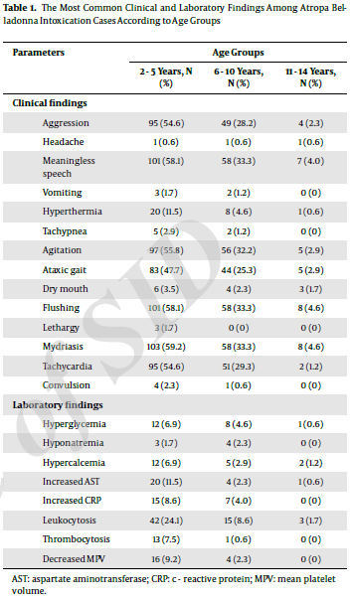
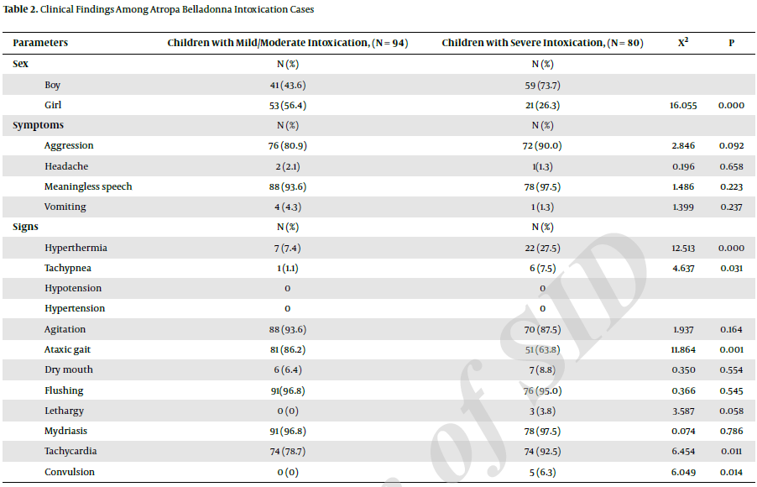
Results

Slide 17
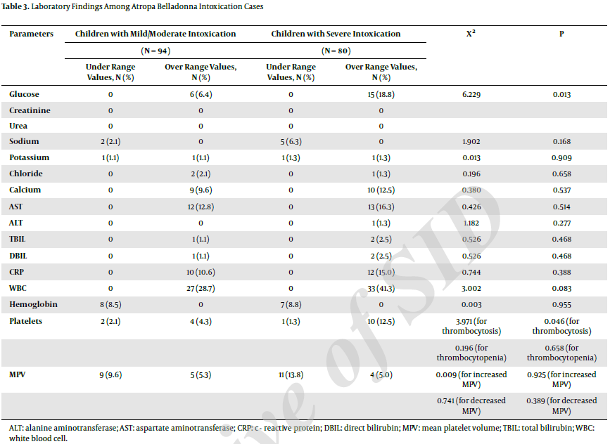
Results

Slide 18
Discussion
According to our study, atropa belladonna intoxication was more common among boys than girls and also more severe; the cause of which may be that the boys often play around rural areas of villages.
We found that children, especially aged 2 - 5 years, were at risk of atropa belladonna intoxication, which may be attributed to that children in this age group are more curiosity to know the environment.
In our study, the most common clinical findings included mydriasis (97.1%), flushing (95.9%), meaningless speech (95.4%), agitation (90.8%), aggression (85.1%), tachycardia (85.1%), and ataxic gait (75.9%), which is in agreement with previous studies (3, 5).
Hyperthermia, tachypnea, tachycardia, and convulsion were seen more often in the severe intoxication group, while ataxic gait in the mild/moderate group. Atropa belladonna - induced hyperthermia may bedue to both inhibition of sweat gland activity and stimulation of temperature centre in the hypothalamus. Children are especially susceptible to atropine fever, which may be seen even at subtherapeutic doses in children.

Slide 19
Discussion
Significant laboratory findings were as following: leukocytosis (34.5%), increased AST (14.4%), increased CRP (12.6%), hyperglycemia (12.1%), decreased MPV (11.5%), hypercalcemia (10.9%), and thrombocytosis (8.1%).
Laboratory findings in poisoning with Atropa belladonna are contradictory in existing literature. Trabattoni et al., reported a case (68 - year - old man) with Atropa belladonna poisoning, who had a blood glucose level of 130 mg/dL; however, his leukocyte count was normal.
Whereas, some case reports showed that laboratory workup was unremarkable except for leukocytosis in such intoxications.
In another case, all the laboratory results were normal. Nonetheless, the studies generally propose that it may be an increase in glucose ,AST (5), ALT (7), and CRP (15) levels and white blood cell (WBC) count (5, 7, 10, 11, 13, 14).
In a comprehensive study, Caksen et al., reported an analysis of 49 children. In this study, laboratory examination revealed leukocytosis in 3 children, hyperglycemia in 17 children, and elevated AST level in 4 children.

Slide 20
Discussion
The results of our study generally agree with the literature. Agarwal et al., suggested that Atropa belladonna poisoning can mimic septicemia because of high WBC count and some other clinical signs. There was an important increase in CRP and WBC in our research. Therefore, we recommend that Atropa belladonna poisoning must be taken into account in differential diagnosis of children with leukocytosis.
Berdai et al., reported a case of intoxication with Atropa belladonna in a child and declared that routine full blood count as well as renal and liver function tests revealed hepatic cytolysis; however, the finding may be due to hepatic side effect of antituberculosis treatment in this case.
In our study, there was significant rise in only AST levels. Due to the fact that liver function tests (ALT, TBIL, DBIL), other than AST, were normal, this rise in AST levels cannot be attributed to liver dysfunction, in our opinion. Renal function tests (urea, creatinine) were also found normal. Based on these results, we can say that active substances in Atropa belladonna do not effect liver and kidney functions.

Slide 21
Discussion
We found that hyperglycemia and thrombocytosis were more common in the severe intoxication group than the mild/moderate intoxication group, which strongly suggests that there may be a causal relationship between atropa belladonna poisoning and these laboratory findings.
Hypercalcemia was present in 10.9% of the cases in our study. Three organs participate in calcium homeostasis: (a) the small intestine, where dietary calcium is absorbed, (b) the skeleton as a calcium reservoir, and (c) the kidney, where calcium is reab- sorbed from the tubular system into blood. Intoxication - induced hypercalcemia may be due to calcium efflux from the skeleton due to the fact that it can rapidly change the serum calcium levels.
In this study, 8.6% of the patients were anemic, however, this situation cannot be attributed to the intoxication because of absence of bleeding or hyperbilirubinemia.
There is no article in the literature that presents clinical and laboratory findings on this topic with this sample size. Our study demonstrates the most common clinical findings and probable laboratory deteriorations in these cases with a large sample size. We believe that the data in this paper can illuminate and inform the clinicians on poisoning with Atropa belladonna.

Slide 22
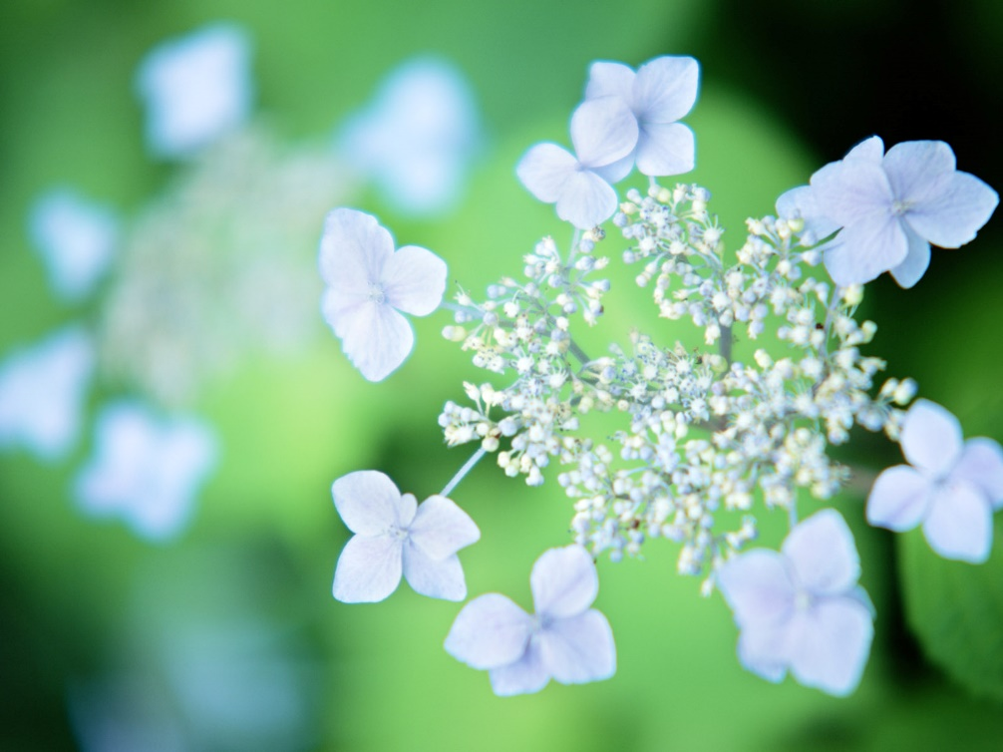
از توجه شما سپاسگزارم

